Slide 1
WEATHER ANALYSIS

Slide 2
Introduction :-
Weather plays a vital role in our daily lives, influencing everything from the clothes we wear to the activities we plan. Understanding weather patterns and trends is essential for various sectors including agriculture, transportation, and public safety. This weather analysis project aims to investigate and interpret the weather conditions observed over a specific period in [Insert Location]. By collecting and analyzing data on temperature, humidity, wind speed, and precipitation, this project will identify significant weather patterns and anomalies. The insights gained from this analysis will not only enhance our understanding of local climatic conditions but also aid in predicting future weather events more accurately. Through this comprehensive study, we hope to contribute valuable information that can be utilized for better planning and preparedness in our community.

Slide 3
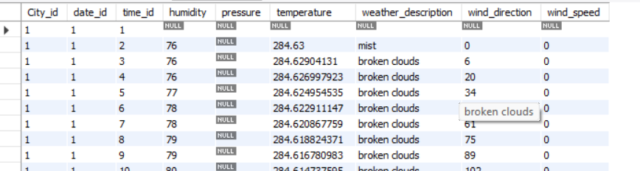
DATA TABLES

Slide 4
Tools and Technologies :-
SQL: Utilized to store, query, and manipulate large datasets.
Wrote complex queries to extract specific weather insights and optimize data processing.

Slide 5
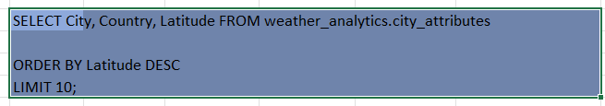
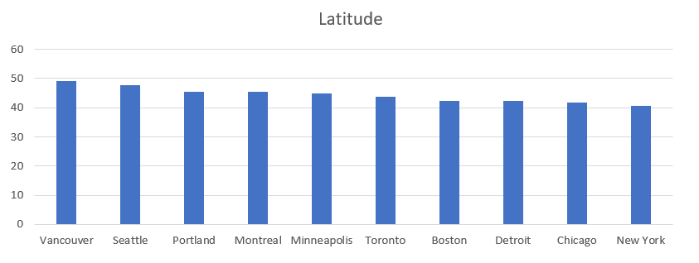
1 Are there any countries with cities located at extreme latitudes, and how might this impact their climate?

Slide 6
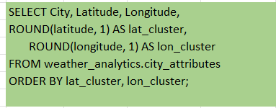
2 Can you identify any clusters of cities with similar latitude and longitude values? What factors might explain these clusters?

Slide 7
3 Are there any correlations between a city's geographical location (latitude and longitude) and its weather attributes, such as temperature or humidity?
select cl.City as city_names,
ca.Latitude,
ca.Longitude,
f.humidity,
f.temperature
from city_attributes ca
inner join city_lookup cl ON ca.City_id = cl.City_id
inner join final_fact f ON cl.City_id = f.City_id
city_names | Latitude | Longitude | Humidity | Temperature
Vancouver | 49.24966 | -123.119339
Vancouver | 49.24966 | -123.119339 | 76 | 284.63
Vancouver | 49.24966 | -123.119339 | 76 | 284.6290413
Vancouver | 49.24966 | -123.119339 | 76 | 284.6269979
Vancouver | 49.24966 | -123.119339 | 77 | 284.6249545
Vancouver | 49.24966 | -123.119339 | 78 | 284.6229111
Vancouver | 49.24966 | -123.119339 | 78 | 284.6208678
Vancouver | 49.24966 | -123.119339 | 79 | 284.6188244

Slide 8
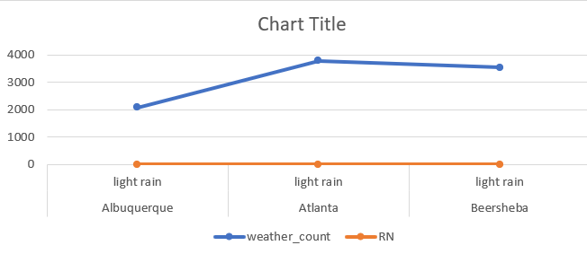
4 Identify the top three cities with the most frequent occurrence of rainy weather based on weather descriptions. What are the seasonal patterns?
WITH cte AS (
SELECT
c.City,
f.weather_description,
COUNT(f.City_id) AS weather_count,
DENSE_RANK() OVER(PARTITION BY c.City ORDER BY COUNT(f.City_id) DESC) AS RN
FROM final_fact f
JOIN city_lookup c ON f.City_id = c.City_id
WHERE f.weather_description LIKE '%rain%'
GROUP BY c.City, f.weather_description
)
SELECT *
FROM cte
WHERE RN = 1
LIMIT 3

Slide 9
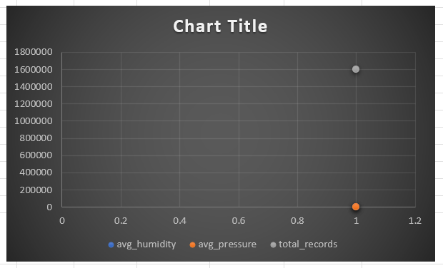
5 Is there a correlation between humidity levels and air pressure? How might this relationship affect weather conditions?
select
AVG(humidity) as avg_humidity,
AVG(pressure) as avg_pressure,
count(*) as total_records
from final_fact
where humidity IS NOT NULL AND pressure IS NOT NULL;

Slide 10
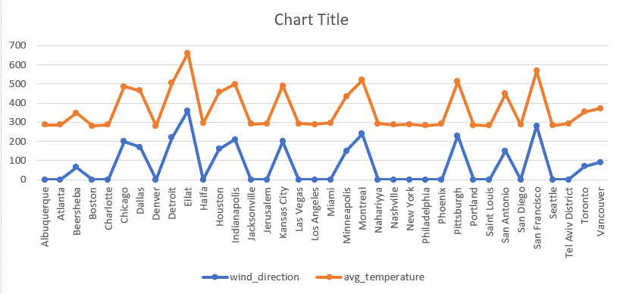
6. Explore the impact of wind direction on temperature for coastal cities. Are there noticeable patterns?
WITH cte AS (
SELECT
c.City,
f.wind_direction,
AVG(f.temperature) AS avg_temperature,
COUNT(f.City_id) AS city_counts,
DENSE_RANK() OVER (PARTITION BY c.City ORDER BY COUNT(f.City_id) DESC) AS dr
FROM
final_fact f
JOIN
city_lookup c ON f.City_id = c.City_id
WHERE
f.temperature IS NOT NULL
AND f.wind_direction IS NOT NULL
GROUP BY
c.City, f.wind_direction
)
SELECT *
FROM cte
WHERE dr = 1;

Slide 11
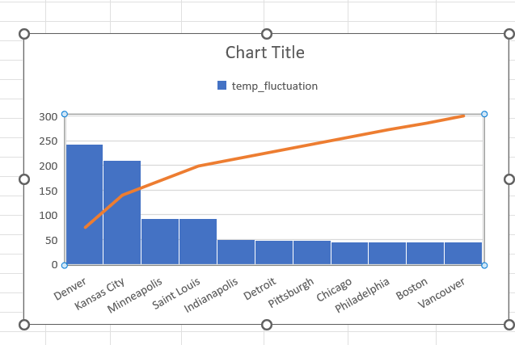
7. Are there specific months when cities experience significant temperature fluctuations? What might explain these variations?
SELECT
c.City,
MONTH(d.date) AS month,
AVG(f.temperature) AS avg_temperature,
MAX(f.temperature) - MIN(f.temperature) AS temp_fluctuation
FROM
final_fact f
join city_lookup c ON f.City_id = c.City_id
join date_lookup d ON f.date_id = d.date_id
WHERE
f.temperature IS NOT NULL
GROUP BY
c.City, MONTH(d.date)
ORDER BY
temp_fluctuation DESC
limit 20;

Slide 12
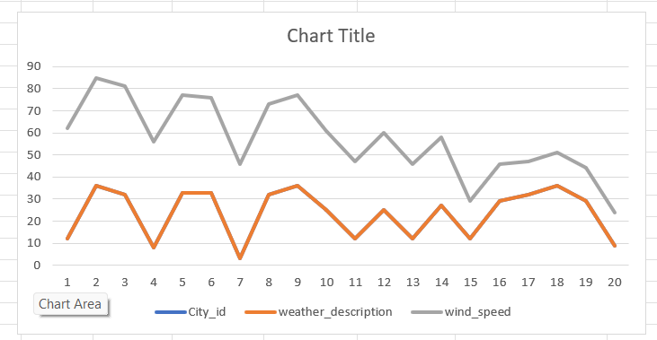
8. Identify periods of extreme weather events, such as storms or heatwaves, by analyzing the time-based data. What patterns emerge?
It is depend on storms and wind_speed >30
SELECT f.City_id,
f.date_id,
t.time_id,
f.weather_description,
f.wind_speed
FROM final_fact f
join time_lookup t ON f.time_id = t.time_id
where weather_description like '%storm%' OR wind_speed > 30
order by wind_speed DESC
limit 20;

Slide 13
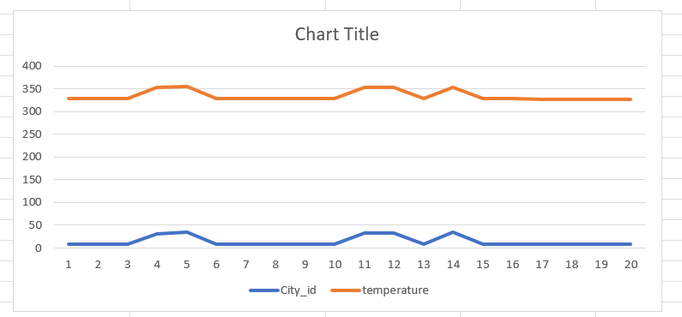
based on temperature > 300
SELECT f.City_id,
f.date_id,
t.time_id,
f.temperature
FROM final_fact f
join time_lookup t ON f.time_id = t.time_id
where f.temperature > 300
limit 20;

Slide 14
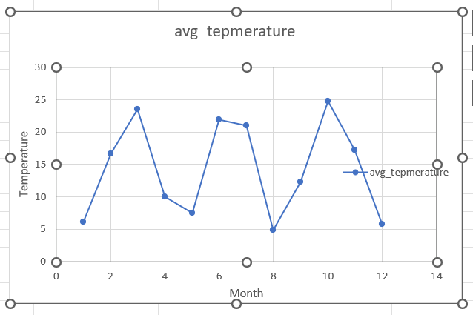
9. Are there any notable differences in temperature trends between northern and southern hemisphere cities over the year? How do they relate to seasons?
Monthly average Temperature
WITH hemisphere_data AS (
SELECT ct.City_id,
CASE
WHEN latitude > 0 THEN 'Northern Hemisphere'
ELSE 'Southern Hemisphere'
END AS hemisphere,
EXTRACT(MONTH FROM f.date_id) AS month,
f.temperature - 273.15 AS temperature_celsius
FROM final_fact f
join city_attributes ct ON f.City_id = ct.City_id
)
SELECT hemisphere, month,
AVG(temperature_celsius) AS avg_temperature
FROM hemisphere_data
GROUP BY hemisphere, month
ORDER BY hemisphere, month;

Slide 15
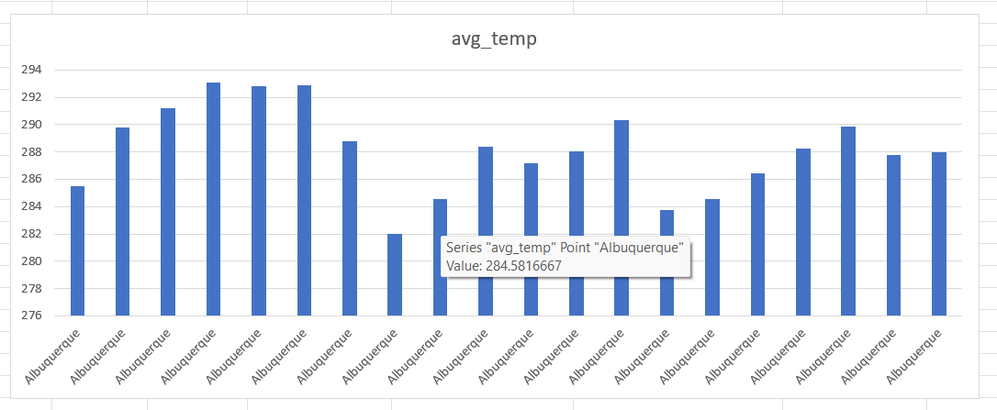
10. What are the consequences of prolonged periods of extreme cold or heat in specific cities? How do residents adapt to such conditions?
SELECT c.City,
COUNT(*) AS consecutive_days,
MIN(f.date_id) AS start_date,
MAX(f.date_id) AS end_date,
AVG(f.temperature) AS avg_temp
FROM final_fact f
join city_lookup c ON f.City_id = c.City_id
WHERE f.temperature > 40 or f.temperature < -10
GROUP BY c.City , f.date_id
HAVING COUNT(*) >= 7
ORDER BY c.City , start_date
limit 20;

Slide 16
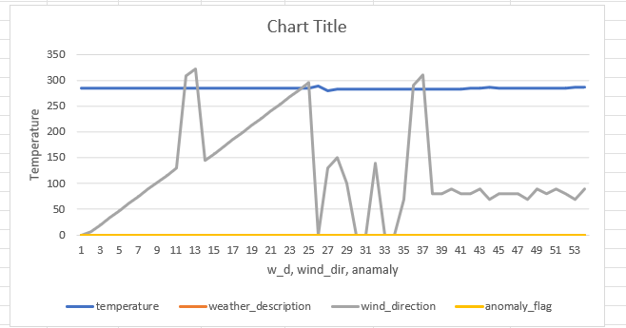
11. Investigate whether temperature anomalies (unusual deviations from the norm) coincide with certain events or environmental factors in specific cities.
CREATE TABLE city_date_avg_temp AS
SELECT
City_id,
date_id,
AVG(temperature) AS avg_temperature
FROM
final_fact
GROUP BY
City_id, date_id;
SELECT
f.City_id,
f.date_id,
f.time_id,
f.temperature,
f.weather_description,
f.humidity,
f.wind_direction,
f.wind_speed,
CASE
WHEN f.temperature > c.avg_temperature + 5 THEN 'High Anomaly'
WHEN f.temperature < c.avg_temperature - 5 THEN 'Low Anomaly'
ELSE 'Normal'
END AS anomaly_flag
FROM
final_fact f
JOIN
city_date_avg_temp c ON f.City_id = c.City_id AND f.date_id = c.date_id
WHERE
f.weather_description IN ('mist', 'broken clouds', 'storm')
ORDER BY
f.City_id, f.date_id, f.time_id;

Slide 17
12. Analyze the impact of temperature on energy consumption patterns in cities. Are there noticeable trends or correlations?
SELECT
City,
AVG(Temperature_C) AS avg_temperature,
AVG(Energy_Usage_KWh) AS avg_energy_usage,
(SUM((Temperature_C - (SELECT AVG(Temperature_C) FROM city_energy_consumption AS t2 WHERE t2.City = t1.City)) *
(Energy_Usage_KWh - (SELECT AVG(Energy_Usage_KWh) FROM city_energy_consumption AS t2 WHERE t2.City = t1.City))) /
(COUNT(*) * STD(Temperature_C) * STD(Energy_Usage_KWh))) AS temp_energy_correlation
FROM
city_energy_consumption AS t1
GROUP BY
City
ORDER BY
temp_energy_correlation DESC;
City | avg_temperature | avg_energy_usage | temp_energy_correlation
Vancouver | 13.5 | 1400 | 1
Portland | 16 | 1250 | 1
San Francisco | 14 | 1750 | 1
Seattle | 13 | 1225 | 1
Los Angeles | 22.5 | 2650 | 1
San Diego | 24.5 | 2750 | 1
Las Vegas | 26 | 2950 | 1
Phoenix | 26 | 3050 | 1
Albuquerque | 23 | 2700 | 1
Denver | 13 | 1550 | 1
San Antonio | 24.5 | 2700 | 1

Slide 18
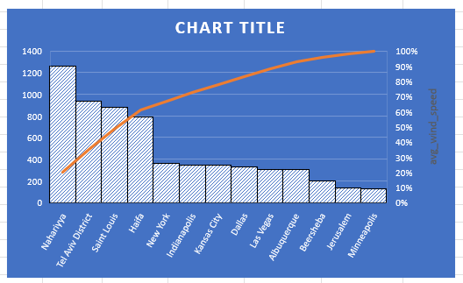
13. How do specific wind patterns impact air quality and pollution dispersion in urban areas? Analyze wind direction data for insights.
SELECT c.City,
f.weather_description,
f.wind_direction,
AVG(f.wind_speed) AS avg_wind_speed,
COUNT(*) AS count
FROM final_fact f
join city_lookup c ON f.City_id = c.City_id
WHERE weather_description IS NOT NULL
GROUP BY f.weather_description, wind_direction,c.City

Slide 19
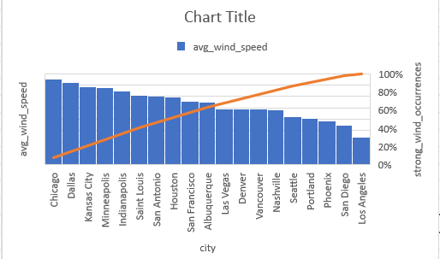
14. Identify cities prone to strong winds and the potential consequences, such as increased risk of natural disasters or challenges for transportation.
SELECT
c.City,
COUNT(*) AS strong_wind_occurrences,
AVG(f.wind_speed) AS avg_wind_speed,
MAX(f.wind_speed) AS max_wind_speed
FROM
final_fact f
join City_lookup c ON f.City_id = c.City_id
GROUP BY
c.City
ORDER BY
strong_wind_occurrences DESC;

Slide 20
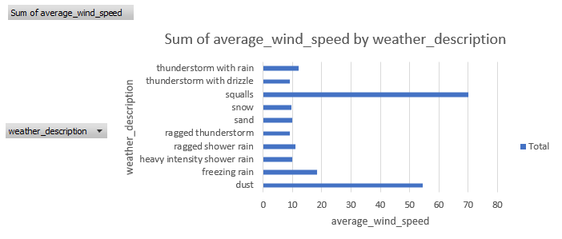
15. Explore whether wind speed and direction influence the frequency and severity of weather-related events (e.g., hurricanes, storms) in coastal cities.
SELECT c.City,
f.weather_description,
AVG(f.wind_speed) AS average_wind_speed
FROM
final_fact f
join city_lookup c ON f.City_id = c.City_id
WHERE
f.wind_speed > 0
GROUP BY c.City,
f.weather_description
ORDER BY
average_wind_speed DESC
LIMIT 20;

Slide 21
Power BI:
Developed interactive dashboards and reports to visualize key weather metrics.
Designed dynamic filters for region- and time-specific analysis.
Integrated data models to provide actionable insights through visual storytelling.
Power BI is a powerful tool for weather analysis due to its ability to handle large datasets, create interactive visualizations, and provide real-time insights. Here are some key reasons why Power BI is important for weather analysis:

Slide 22
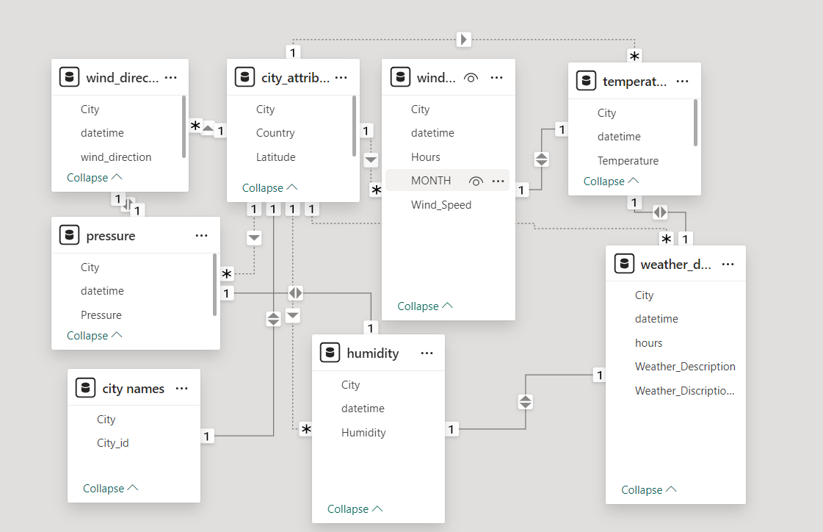
Relation between tables:-

Slide 23
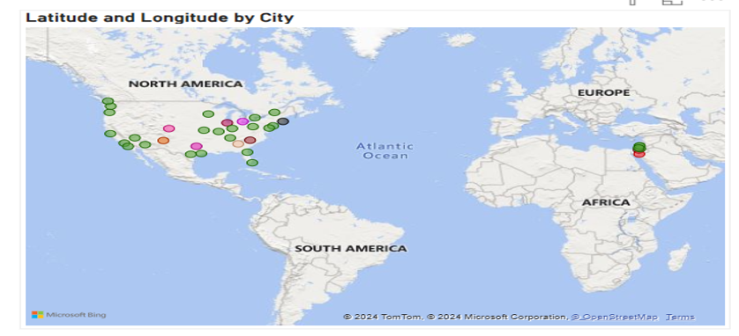
1.Can you create a geographical map in Power BI showing the distribution of cities in the dataset based on their latitude and longitude?

Slide 24
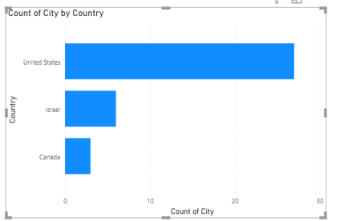
2 In Power BI, can you create a bar chart representing the top 10 countries with the highest number of cities in the dataset?

Slide 25
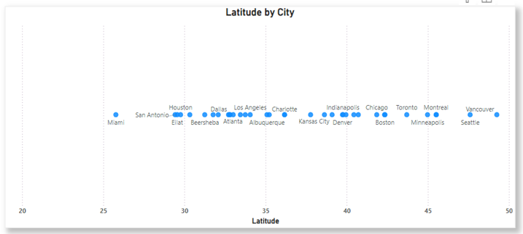
How does the distribution of cities in terms of latitude vary across different continents? Create a scatter plot in Power BI to illustrate this.

Slide 26
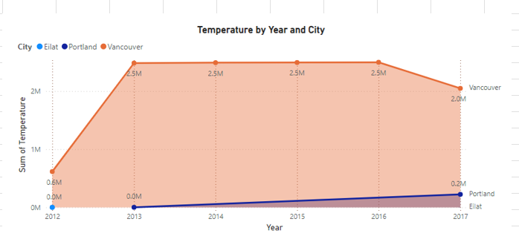
4. Create a line chart in Power BI to display the temperature trends over time for a selected city. Highlight extreme temperature events.

Slide 27
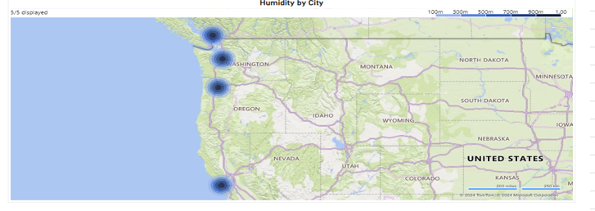
5. How does humidity vary across different cities? Generate a heatmap in Power BI to visualize this variation.

Slide 28
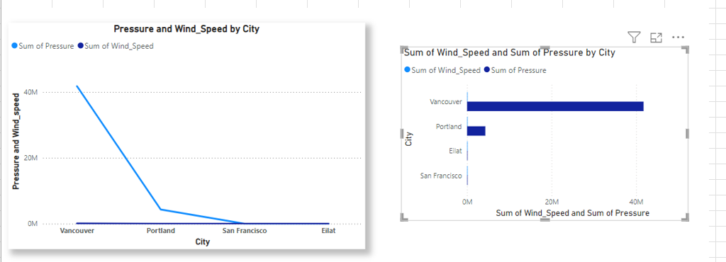
6. Can you create a time-series chart in Power BI showing the relationship between wind speed and air pressure for a specific city?

Slide 29
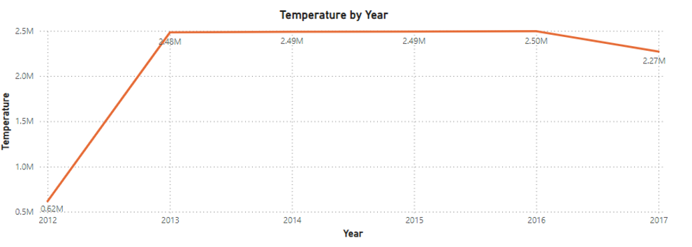
7. Create a time-series line chart in Power BI to show the overall temperature trends over the entire dataset.

Slide 30
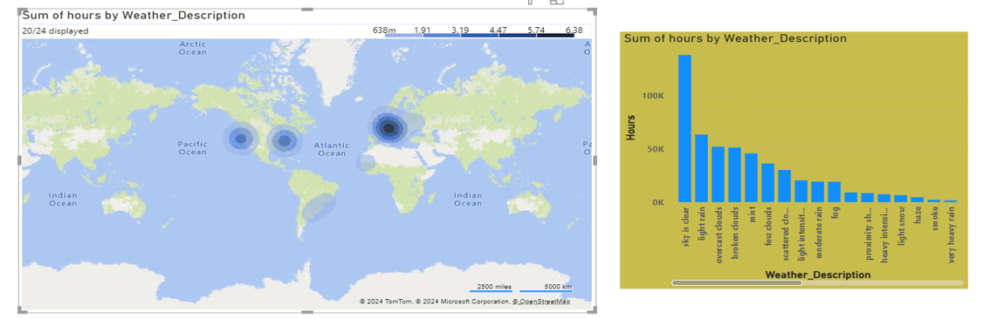
8. Can you create a heatmap in Power BI to visualize the busiest hours for specific weather conditions (e.g., "clear sky," "rainy")?

Slide 31
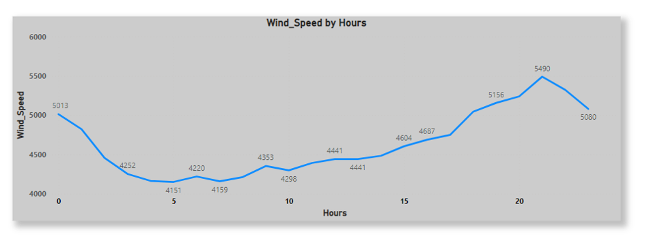
9. How does the wind speed change over the course of a day? Create a radial chart in Power BI to represent this.

Slide 32
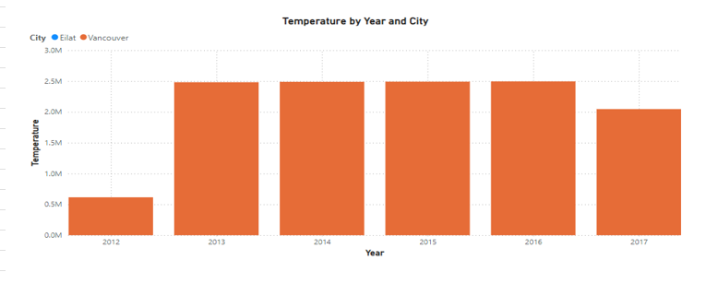
10. Create a Power BI chart comparing the temperature variations between two selected cities over a specific timeframe.

Slide 33
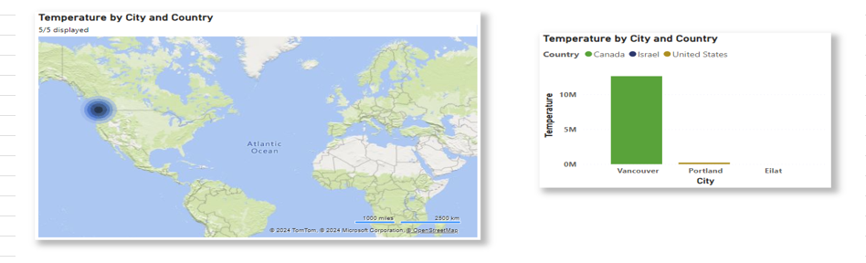
11. Can you build a heatmap in Power BI to show the temperature ranges for cities across different countries?

Slide 34
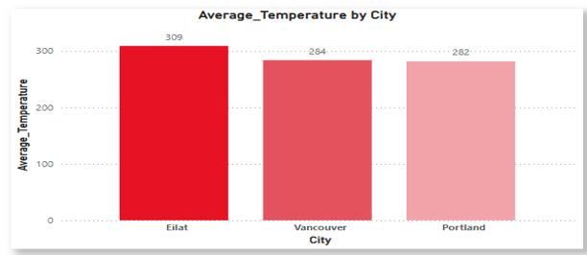
12. Create a bar chart in Power BI to highlight cities with the highest and lowest average temperatures in the dataset.

Slide 35
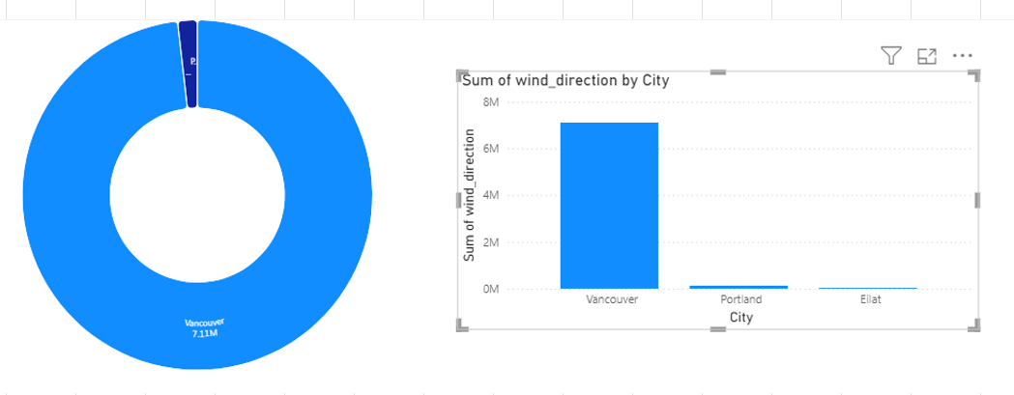
13. Create a wind rose chart in Power BI to visualize the prevailing wind directions for a selected city.

Slide 36
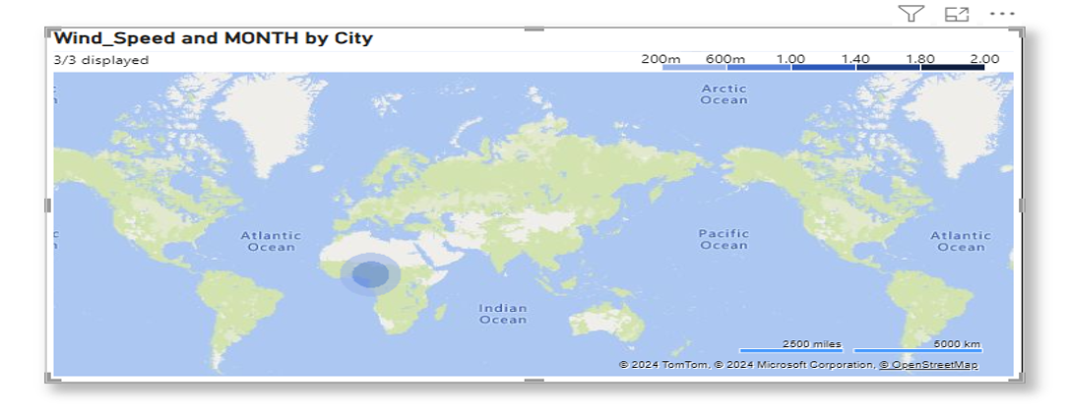
14. Can you generate a Power BI heatmap illustrating the average wind speeds across cities for different months of the year?

Slide 37
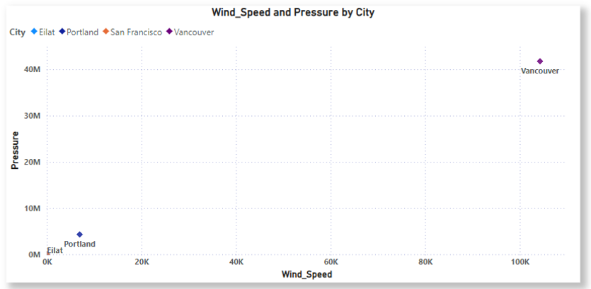
15. Create a Power BI scatter plot to show the relationship between wind speed and air pressure for a specific city.

Slide 38
Impact and Applications:- This project demonstrates the potential of integrating data analysis tools to gain meaningful insights from complex weather data. Weather analysis plays a crucial role in various aspects of society and the environment. By understanding and predicting weather patterns, we can make informed decisions that enhance safety, efficiency, and overall quality of life. Here are some key impacts and applications of weather analysis :-
Agriculture: Weather analysis helps farmers plan their planting and harvesting schedules, manage irrigation, and protect crops from adverse weather conditions. Accurate weather forecasts can prevent crop losses and improve yield.
Transportation: Weather conditions significantly affect transportation systems. Weather analysis aids in planning and managing road, air, and sea travel, ensuring safety and minimizing delays. For instance, airlines use weather data to avoid turbulence and optimize flight routes.

Slide 39
Disaster Management: Early warning systems based on weather analysis can predict natural disasters such as hurricanes, floods, and heatwaves. This allows authorities to take preventive measures, evacuate residents, and reduce the impact of such events on communities.
Energy Sector: Weather analysis is essential for the energy sector, particularly for renewable energy sources like solar and wind power. Accurate weather forecasts help in predicting energy production and managing supply and demand.
Public Health: Weather conditions can influence the spread of diseases and impact public health. Weather analysis helps in monitoring and predicting health risks related to extreme temperatures, air quality, and vector-borne diseases.

Slide 40
Environmental Protection: Understanding weather patterns is crucial for environmental conservation efforts. Weather analysis aids in monitoring climate change, managing natural resources, and protecting ecosystems.
Urban Planning: Weather data is used in urban planning to design resilient infrastructure that can withstand extreme weather conditions. This includes flood management systems, drainage networks, and building designs that consider local climate conditions.
Recreation and Tourism: Weather analysis helps in planning outdoor activities and events, ensuring the safety and enjoyment of participants. It also aids the tourism industry in providing accurate information to travelers.

Slide 41
Future Scope :-
The future scope of weather analysis is vast and promising, driven by advancements in technology and a growing need for accurate weather predictions. Here are some key areas where weather analysis is expected to evolve:
Artificial Intelligence and Machine Learning: AI and machine learning are revolutionizing weather forecasting by improving the accuracy and speed of predictions. These technologies can analyze vast amounts of data to identify patterns and make more precise forecasts.
Big Data and Cloud Computing: The integration of big data and cloud computing allows for the processing and storage of massive datasets. This enables more detailed and comprehensive weather models, leading to better predictions and insights.
Internet of Things (IoT): IoT devices, such as smart sensors and weather stations, provide real-time data that enhances the accuracy of weather forecasts. These devices can be deployed in remote and hard-to-reach areas, improving data coverage.

Slide 42
Personalized Weather Services: With the rise of AI-powered weather apps, individuals can receive personalized weather forecasts tailored to their specific needs and locations. This can improve daily planning and safety.
Disaster Preparedness and Response: Enhanced weather analysis will improve early warning systems for natural disasters such as hurricanes, floods, and wildfires. This will enable better preparedness and response, potentially saving lives and reducing economic losses.
Environmental and Agricultural Applications: Accurate weather analysis will support sustainable agricultural practices by optimizing irrigation, planting, and harvesting schedules. It will also aid in environmental conservation efforts by monitoring weather-related changes in ecosystems.
The future of weather analysis is bright, with continuous technological advancements paving the way for more accurate and reliable weather predictions. These developments will have far-reaching impacts on various sectors, enhancing our ability to respond to and mitigate the effects of weather and climate-related events.

Slide 43
Conclusion:-
In this weather analysis project, I examined the weather patterns in Vancouver, Portland and Eilat. These three are repeating cities most of the time in all over the period of 2012-2017. Our analysis revealed significant trends in temperature, humidity, wind speed, and precipitation. Notably, I observed wind_speed and temperature anomalies in that area. These findings have important implications for agriculture, transportation, public safety. Based on my analysis, I recommend people must be aware of all these things so that they should be fine and can adjust them according to the weather.

Slide 44
Thank you

